Slide 1
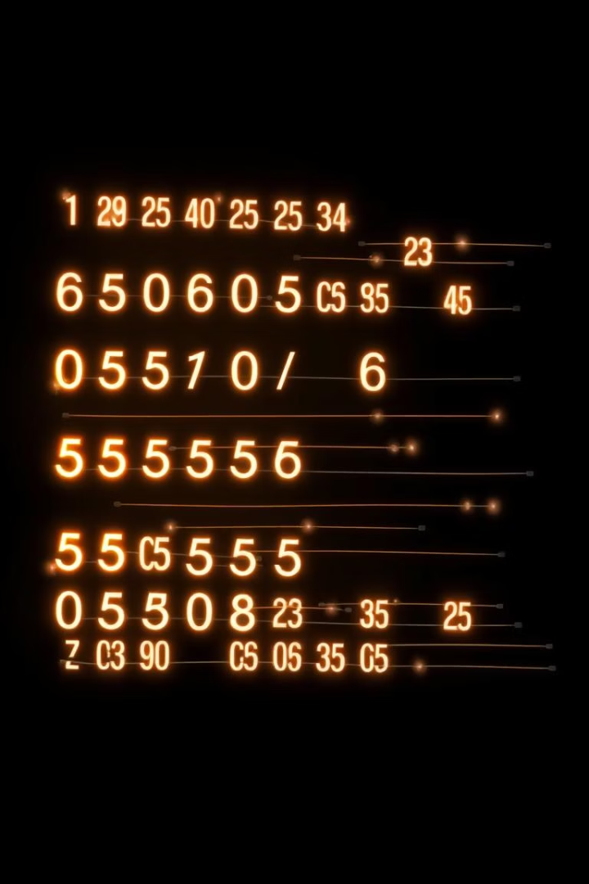


Python 2D Arrays: Fundamentals and Operations
Explore Python's 2D arrays, also known as matrices. This presentation covers creation, access, modification, and iteration. We will use standard Python lists and NumPy arrays for examples.
by Ramsriprasaath

Slide 2
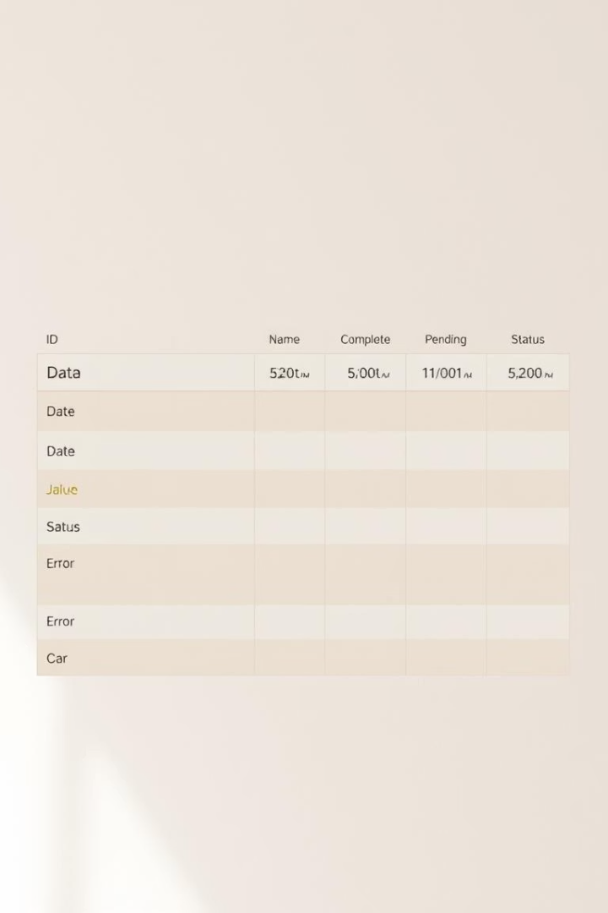
What are 2D Arrays?
Lists of Lists
In Python, 2D arrays are simply lists of lists.
Table Analogy
Think of them as rows and columns in a table or spreadsheet.
Example Structure
An example is: [[1, 2, 3], [4, 5, 6], [7, 8, 9]].
Versatile Uses
They represent matrices, images, or game boards effectively.

Slide 3
Creating 2D Arrays
List Comprehension
Direct Initialization
Using NumPy
Use nested list comprehensions:
Manually define elements:
Import NumPy:
matrix = [[0 for col in range(3)] for row in range(4)]
matrix = [[1, 2, 3], [4, 5, 6], [7, 8, 9]]
import numpy as np
Create arrays:
This creates a 4x3 matrix of zeros.
This offers direct control over values.
matrix = np.zeros((4, 3))
or
matrix = np.array([[1, 2, 3], [4, 5, 6]])

Slide 4




Accessing Elements
Standard Python Lists
Access elements using
matrix[row_index][col_index]
. For example,
matrix[0][1]
accesses the element at row 0, column 1. The result would be '2'.
NumPy Arrays
NumPy uses simplified indexing:
matrix[row_index, col_index]
. For instance,
matrix[0, 1]
in NumPy also accesses the element at row 0, column 1. The result would be '2'.
Example Access
To access element in row 2, column 3 (using 0-based indexing for a 3x3 matrix like [[1, 2, 3], [4, 5, 6], [7, 8, 9]]):
element = matrix[1][2]
This would yield '6'.

Slide 5

Modifying Elements
Direct Assignment
NumPy Modification
Change elements directly:
NumPy uses the same syntax as accessing, then assign the value:
matrix[row_index][col_index] = new_value
matrix[1, 2] = 10
. For example, setting
. This is efficient for large arrays.
matrix[1][2] = 10
changes the element at row 1, column 2 to 10.
Practical Example
To change the element in row 0, column 0 to 5:
matrix[0][0] = 5
. This updates the first element in the array.

Slide 6
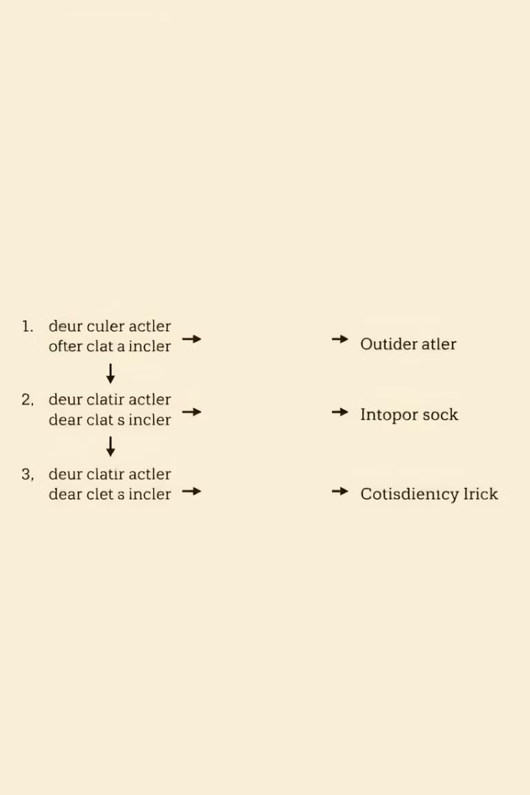
Iterating Through 2D Arrays
Nested Loops (Row-wise)
Iterate using:
for row in matrix: for element in row: print(element)
. This prints elements row by row.
Using Indices
Access elements by index:
for i in range(len(matrix)): for j in range(len(matrix[0])): print(matrix[i][j])
This provides control over row and column.
NumPy Flattening
For simple iteration with NumPy:
for element in matrix.flatten(): print(element)
. This iterates over all elements linearly.

Slide 7








Advanced Operations with NumPy
Matrix Operations
Perform element-wise addition/multiplication:
Slicing
matrix1 + matrix2
Extract sub-arrays efficiently. Example:
,
sub_matrix = matrix[1:3, 0:2]
matrix1 * matrix2
selects rows 1-2 and columns 0-1. This is a powerful feature.
. For true matrix multiplication, use
np.dot(matrix1, matrix2)
.
Transpose
Reshaping
Swap rows and columns easily. Use
Change array dimensions without changing data. Example:
transposed = matrix.T
reshaped = matrix.reshape((2, 6))
. This operation is fundamental in linear algebra.
transforms a 3x4 to 2x6. This is flexible.

Slide 8




Libraries for 2D Arrays
NumPy
SciPy
Pandas
Provides efficient numerical operations. It offers vectorization, broadcasting, and linear algebra tools. It's the foundation for scientific computing.
Builds on NumPy for scientific computing. It includes modules for sparse matrices and image processing. It's ideal for advanced tasks.
Specializes in data analysis and manipulation. Its DataFrame object handles tabular data effectively. It's essential for data science workflows.

